Slide 1

A Vocational Training Presentation on NexusPrep: A Smart Study Assistance Platform
Submitted to
DEPARTMENT OF COMPUTER SCIENCE AND ENGINEERING
Bhilai Institute of Technology, Durg
An Autonomous Institute Affiliated to
Chhattisgarh Swami Vivekanand Technical University, Bhilai (CG)
In partial fulfillment of requirement for the award of the degree of
Bachelor of Technology in
Computer Science and Engineering
Submitted by:
Anupam Sharma, 300102223023
CD8391

Slide 2
INTRODUCTION
Project Concept: An AI-driven study platform that converts raw academic material — textbook PDFs, scanned notes, and previous year question papers — into structured, interactive study aids across two dedicated modes.
The Need: Effective revision depends on spaced repetition and active recall, but manually preparing flashcards, summaries, and exam-focused strategy from raw material is slow, tedious, and inconsistent.
Objective: To automate the journey from raw document to revision-ready content, while reliably handling real-world conditions like scanned/unclear PDFs and unpredictable AI API behavior.
Core Philosophy: Pairing Large Language Model reasoning (Google Gemini) with the Ebbinghaus Forgetting Curve — generating study content is only half the job; scheduling its revision is the other half.

Slide 3
PROBLEM STATEMENT
The Time Sink Bottleneck: Manually reading a chapter and authoring flashcards or summaries from it consumes hours that could otherwise go toward actual studying.
The Unstructured-Input Gap: Real student material is rarely clean — scanned photocopies and phone-photographed notes have no machine-readable text at all, and most tools can't handle that.
The Study-Strategy Gap — Comprehension study and targeted exam preparation are fundamentally different tasks, yet most existing tools offer only one generic mode for both.
The Retention Gap: Without a spacing schedule, information reviewed once is largely forgotten within days — and few students track revision manually or consistently.

Slide 4
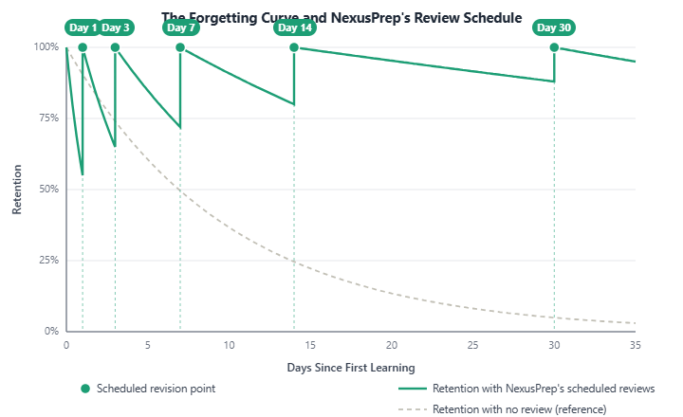
EBBINGHAUS FORGETTING CURVE
The Science: Psychologist Hermann Ebbinghaus found that memory retention decays sharply within the first few days of learning something new, then levels off — forgetting is fast at first, not linear.
The Fix — Spaced Repetition: Reviewing information right before it's forgotten resets the curve, so each next review can wait longer than the last.
NexusPrep's Schedule: Flashcards are auto-scheduled at Day 1, 3, 7, 14, and 30 — modeled directly on this curve.

Slide 5
REQUIREMENTS
Language & Environment: Python 3.10+ (FastAPI, Uvicorn) for the backend; JavaScript with React 18 + Vite for the frontend.
Data Extraction: PyMuPDF (native PDF text extraction), with Gemini Vision OCR as an automatic fallback for scanned or image-based documents.
Database: MongoDB Atlas (cloud-hosted, async via Motor) — stores users, OTPs, and flashcard decks.
AI & LLM Stack: Google Gemini API
gemini-2.5-flash: Primary model used for all content generation and document validation.
Fallback chain: Automatically retries against gemini-3.1-flash-lite and gemini-3.5-flash if the primary model is rate-limited or unavailable.
Email Dispatch: Brevo transactional email API — used for OTP verification, password resets, and revision reminders.

Slide 6
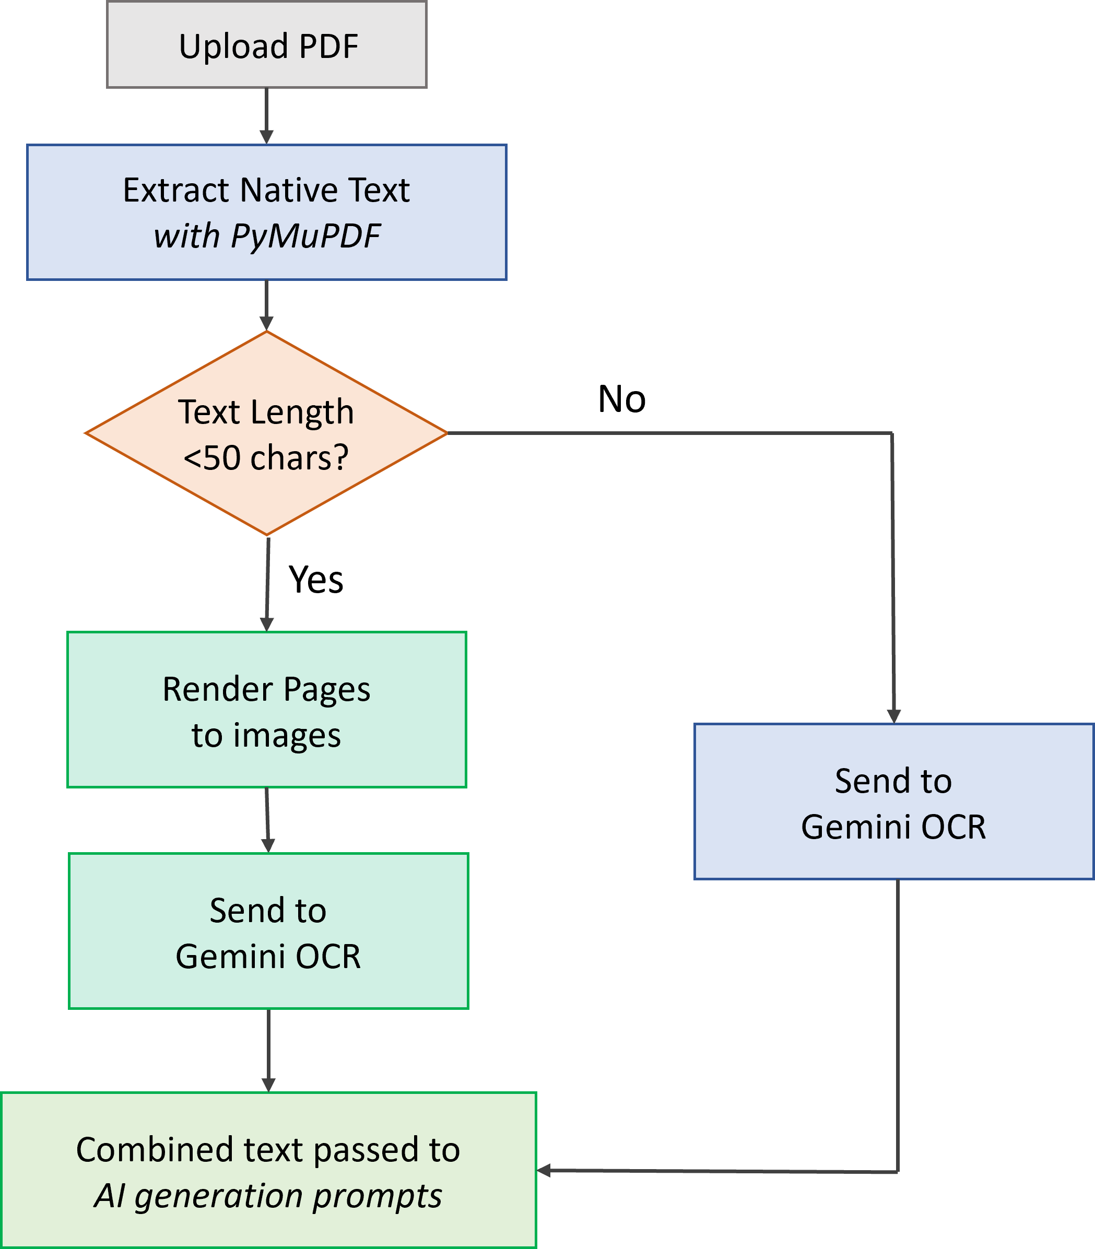
METHODOLOGY
AI Orchestration Pipeline: The core framework ensuring reliable, structured content generation from raw, often messy student documents — with built-in fallback at every stage.
Data Flow Pipeline:
Document Upload: User submits PDF(s) — study notes, PYQs, or textbook chapters.
Text Extraction: Native text pulled via PyMuPDF; OCR fallback triggers automatically if extraction yields too little text.
AI Validation: Gemini checks that uploaded content is genuine educational material before expensive generation calls run.
Content Generation: Structured prompts dispatched concurrently to Gemini for summaries, flashcards, or exam strategy.
Persistence: Generated flashcard decks stored in MongoDB, linked to the user's account.
Revision Scheduling: Ebbinghaus-based spaced-repetition engine schedules the next review automatically.

Slide 7
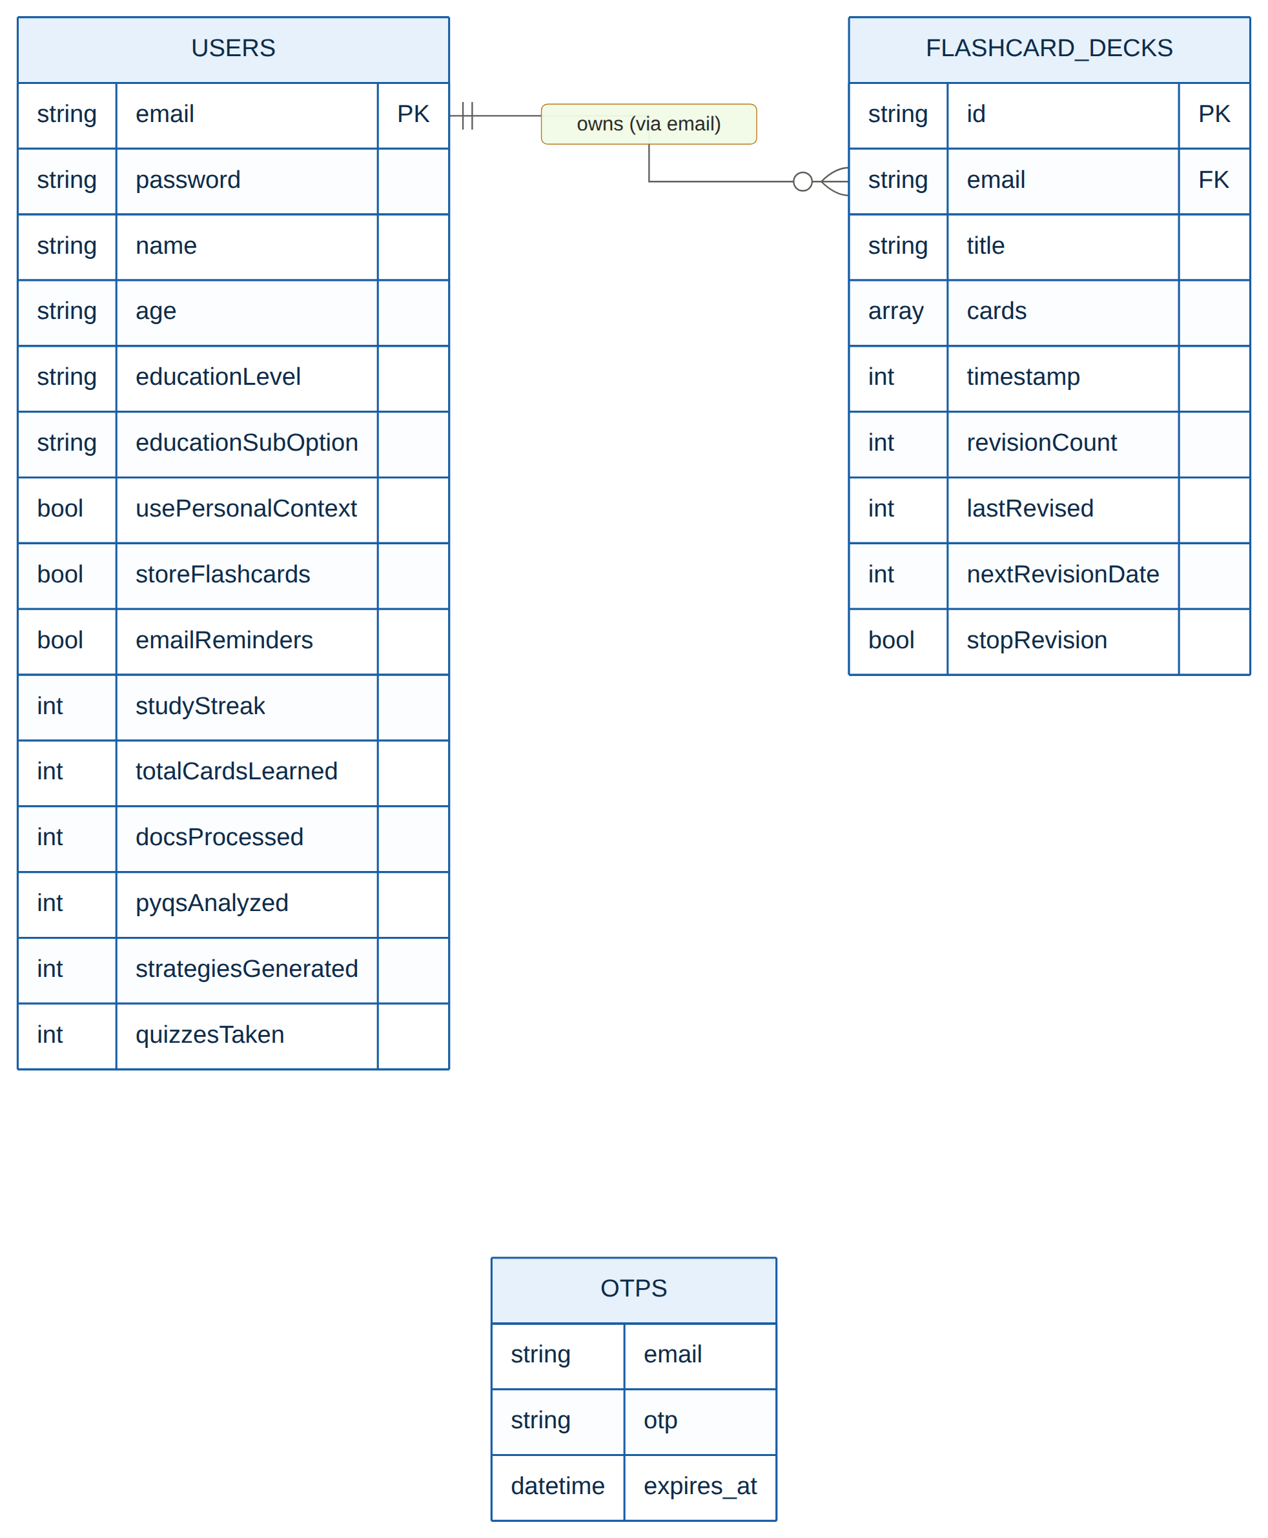
DATABASE DESIGN
MongoDB (Cloud-Hosted): A schemaless, document-oriented database chosen specifically because flashcard decks are naturally nested, variable-length structures — a poor fit for rigid relational tables.
Core Collections:
users: Account credentials, profile info, preferences, and lifetime usage statistics.
otps: Transient 6-digit verification codes with a 10-minute expiry, used during registration.
flashcard_decks: Each deck's title, cards, and spaced-repetition scheduling fields — linked to its owner via email.

Slide 8
PHASE 1- INGESTION & OCR FALLBACK
Native Text Extraction: PyMuPDF reads embedded text directly from digitally-typed PDFs — the fast path for the majority of uploaded material.
OCR Fallback via Gemini: If extracted text falls below 50 characters, pages are rendered as images and transcribed using Gemini's multimodal vision instead of a classical OCR engine.
Gemini Over Traditional OCR: Contextual understanding lets it correctly interpret messy handwriting, faint scans, and partially obscured text far better than character-matching-based engines.

Slide 9
PHASE 2- AI ORCHESTRATION
Two Modes, One Engine: Every uploaded document is routed through one of two purpose-built generation pipelines, depending on what the student actually needs.
Normal Mode: Generates a subject title, chapter-wise takeaways, LaTeX-formatted formulas, key definitions, and 15–20 flashcards — built for general comprehension.
Exam Mode: Cross-references Notes against PYQs (after validating they're the same subject), producing high-yield topics, strategic insights, and 4/8-mark predicted questions plus a challenging MCQ quiz
Strict Prompting: Every generation call enforces structured JSON output and consistent math-formatting rules, so results render reliably on the frontend.

Slide 10
OUTPUT AND RESULTS
Intelligent Synthesis & Predictive Generation: Successful transformation of unstructured academic PDFs into study aids and targeted exam strategies.
Key Deliverables:
Normal Mode Synthesis: Successfully generates concise chapter takeaways, extracts complex mathematical formulas , and creates ready-to-study flashcard decks.
Exam Mode Predictions: Accurately cross-references Notes and PYQs to output High-Yield Topics, strategic exam insights, and highly probable 4-mark and 8-mark descriptive questions.
Mathematical Integrity: Renders complex equations and Greek letters via KaTeX, completely bypassing generic AI formatting corruption.
Spaced Repetition Engine: Decks are successfully persisted in MongoDB and automatically scheduled for review at Ebbinghaus intervals (1, 3, 7, 14, 30 days).

Slide 11
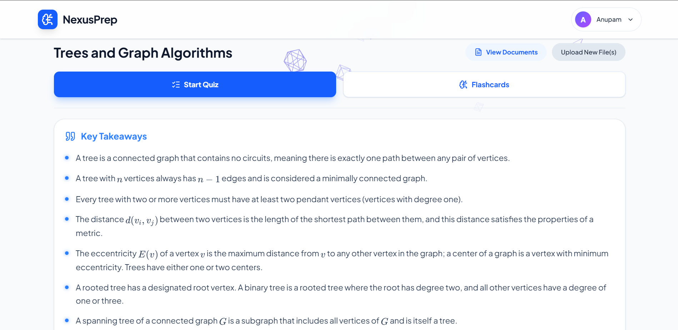
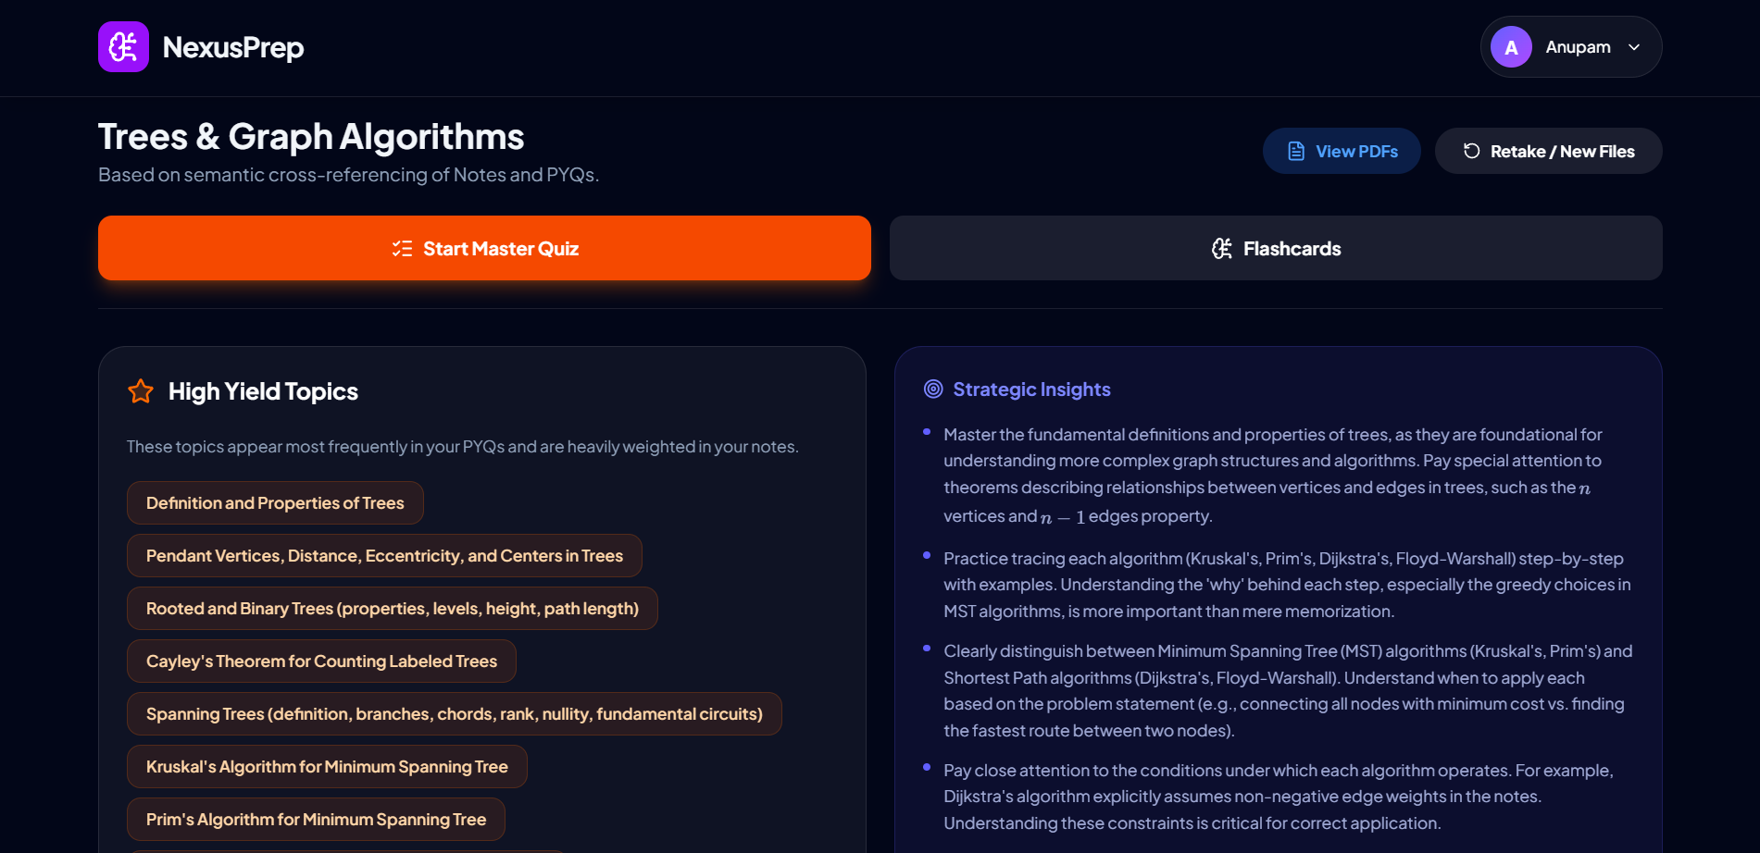
Normal Mode Results Dashboard with Key Takeaways, Quizes, Flashcards, and rendered formulas
Exam Mode Results Dashboard with High Yield Topics, Strategic Insights, and predicted questions

Slide 12
CONCLUSION & FUTURE SCOPE
CONCLUSION:
Eliminated manual study prep by transforming raw PDFs into mathematically accurate (LaTeX) interactive assets.
Successfully cross-referenced Notes and PYQs to accurately predict high-yield topics and targeted exam questions.
Promoted active recall using a cloud-synced Ebbinghaus Spaced Repetition engine with automated email reminders.
FUTURE SCOPE:
Expanding MongoDB and WebSockets to enable multi-user environments for sharing and co-editing flashcard decks.
Re-introducing local vector databases (ChromaDB) for deep, offline semantic querying of massive textbook datasets.
Expanding the pipeline to directly ingest, transcribe, and synthesize lecture audio and video recordings.

Slide 13
THANK YOU

